Slide 1
Lecture Makeup 27th Jan (CNY Monday) → 29th Jan (Wed) Timing?
Will check with class reps

Slide 2
Cryptographic Hash
Message Authentication Code (MAC)
“Cryptography and Network Security” by W. Stallings

Slide 3
Content
What is Message Authentication Code (MAC)
MAC function requirements
Application of MAC
Hash based MAC (HMAC)
Symmetric cipher based MAC, Data Authentication Algorithm (DAA)

Slide 4
What is MAC?
MAC is short for Message Authentication Code
MAC is effectively a cryptographic checksum of the message
MAC [generated by a MAC function] provides Message Authentication by validating the sender

Slide 5
Message Authentication Code (MAC)
Generated by an algorithm that creates a small fixed-sized block
Appended to message as a “signature”
Receiver performs same computations on message and checks it matches the MAC
Provides assurance that message is unaltered and comes from a particular sender
Notes:
An alternative authentication technique involves the use of a secret key to generate a small fixed-size block of data, known as a cryptographic checksum or MAC that is appended to the message. This technique assumes that two communicating parties, say A and B, share a common secret key K. A MAC function is similar to encryption, except that the MAC algorithm need not be reversible, as it must for decryption.

Slide 6
What is MAC? (Cont)
Question
James wrote this message? Are you sure?
This is a secret message. We need more $$$ & time for the project, please vote against it. James

Slide 7
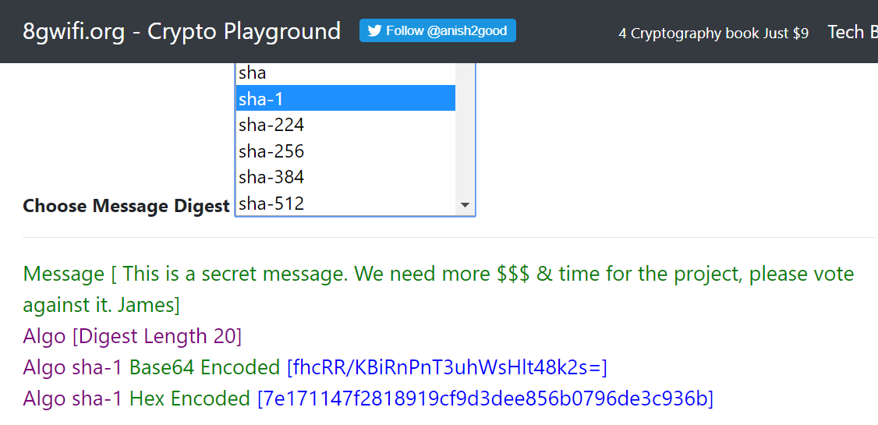
Try
Generate a Hash digest
Message : This is a secret message. We need more
$$$ & time for the project, please vote against it. James
Algorithm / function used : SHA-1
Online resource : https://8gwiﬁ.org/MessageDigest.jsp
In the 8gwiﬁ website. HMAC is a subtype of MAC, while Message digest is the Hash digest

Slide 8
What is MAC? (Cont)
Question
Would a hash digest helps?
This is a secret message. We need more $$$ & time for the project, please vote against it. James
SHA-1 : 7e171147f2818919cf9d3dee856b0796de3c936b
Hash → provides the assurance that a message is unaltered accidentally, ( data integrity)
… BUT not protected against MITM attack
The attacker intercepted the original message and sent you a fake one with the required message digest (based on the fake message)

Slide 9
Try Again
Generate a Mac code
Message : This is a secret message. We need more
$$$ & time for the project, please vote against it. James
Secret key : secret
Algorithm / func4on used : SHA-1
Online resource : https://8gwiﬁ.org/hmacgen.jsp
Important : When using MAC, both the sender and the receiver have a common secret key.

Slide 10
What is MAC? (Cont)
The receiver can verify the message is indeed from the sender by (1) re-generate the MAC and
(2) compare against the sent MAC
This is a secret message. We need more $$$ & time for the project, please vote against it. James
[HmacSHA1] ba4568f9db56c7c1ffd1872d61f1e77bcb8ab3f0
MAC → provides the assurance that a message is unaltered (data integrity) and comes from the sender (authentication).

Slide 11
MAC function requirements
Description | Desired features
Input (data / message) length | Variable Size
Output (MAC code) length | Fixed Size
Encryption Key | ✔ Required
Speed of Processing | As fast as possible
Many-to-one function (message + key → MAC code) Computationally diﬃcult to ﬁnd 2 identical MAC code with 2 input variables. | ✔
Notes:
Special Attention Required

Slide 12
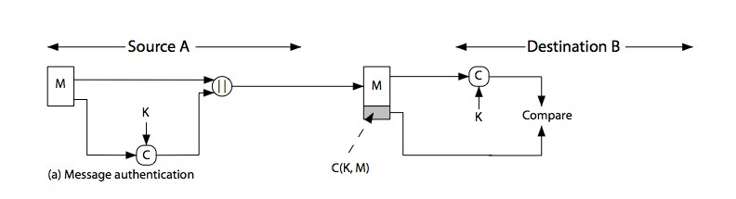
MAC application
MAC algorithms
Generate a small ﬁxed-size block called authenticator / authentication tag / tag / MAC / MAC code / cryptographic checksum
Output depending on message + key
Need not be reversible
MAC appended to message , validated by the receiver

Slide 13
MAC application
MAC with message encryption
For secrecy with authentication.
Preferred processing (from most to least secure)
Encrypt-then-MAC - Encrypt message then generate MAC from the ciphertext + IV
MAC-and-Encrypt - Generate MAC and encrypt both MAC and message
Encrypt-and-MAC - Generate MAC and encrypt message only
MAC without message encryption
For authentication and data integrity only
Usually separate keys for each communication pair.
Notes:
Special Attention Required

Slide 14
Keyed Hash Function as MAC
MAC algorithms based on a hash function
Generally faster
Widely available / well understood
Need modification to use a key
Original (bad) proposal:
KeyedHash = Hash(Key|Message)
Prepending a key to message → Hash
Weaknesses found
→ Development of HMAC
Notes:
The original proposal is subjected to length extension attack:
The key to understanding hash extension attacks is to understand that the hash output isn't just the output of the machine generating the hash, it's also the state of the machine up till that point. In other words, just the hash output alone contains enough information for you to keep going and append more content to the hashed input.
When M (the message) and Hash(Key||M) are known it is possible to fabricate a M' which is an extension of M ie. M' = M||X. Just need to compute the Hash value of X using Hash(Key||M) as the starting hash state. The final hash value will pass the Hash(Key|| M') test.
~ref: https://crypto.stackexchange.com/questions/3978/understanding-the-length-extension-attack

Slide 15
Hash based Message Authentication Code (HMAC)
Speciﬁed as Internet standard RFC2104
HMAC_{K} = Hash[(K⁺ XOR opad) ||
Hash[(K⁺ XOR ipad)||M)]]
where K⁺ is the key padded to the block size
and opad, ipad are speciﬁed padding constants
Small overhead - 3 more blocks of hash calculations
- No encryption computation is required.
Could use any hash function
eg. MD5, SHA-1, RIPEMD-160, Whirlpool
Notes:
HMAC uses a two passes hash computation. (No encryption is required)
ipad -> inner key pad
opad -> outer key pad

Slide 16
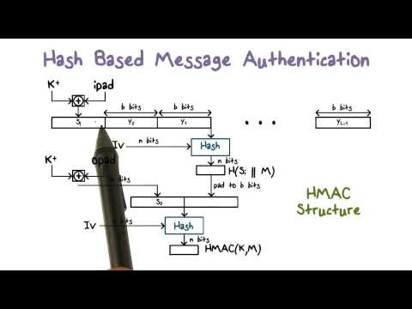
HMAC
https://www.youtube.com/watch?v=cBuHXDWp5Ek

Slide 17
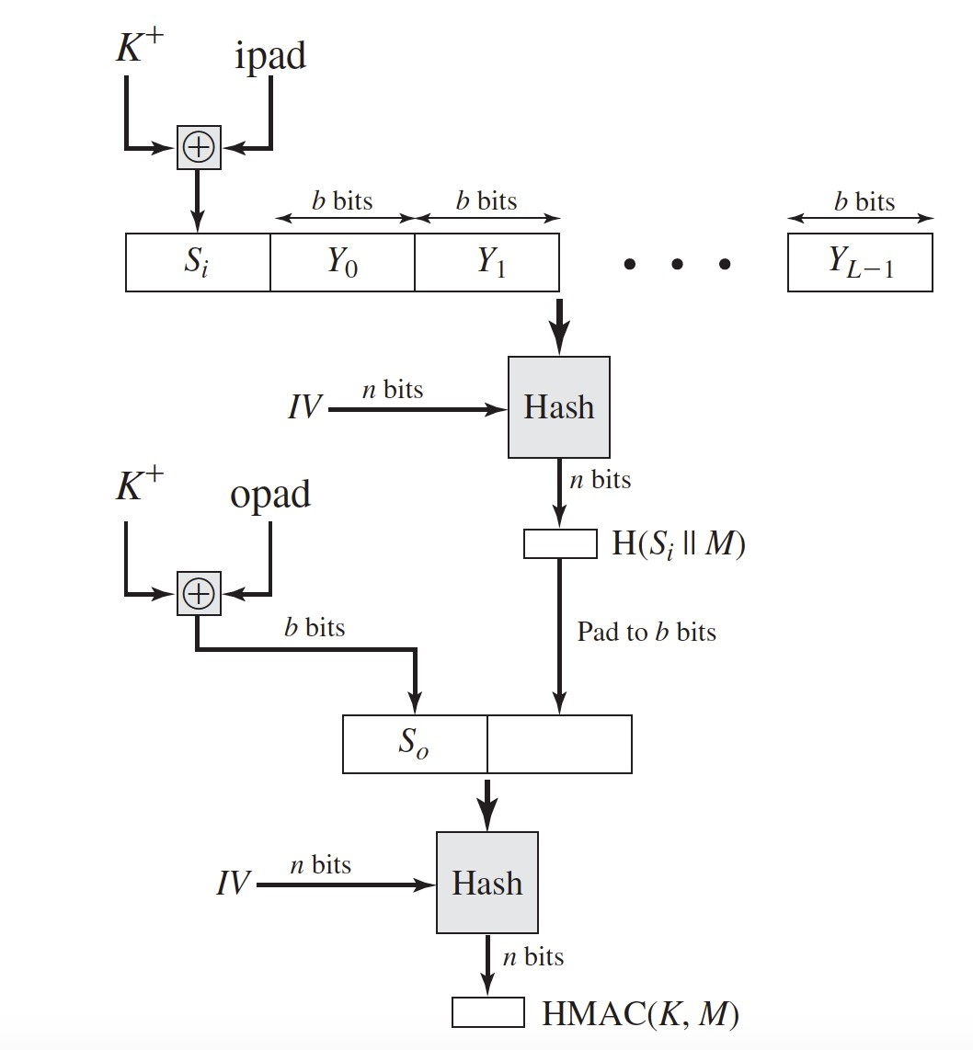
HMAC Overview
Elements are:
K⁺ is the K (key) padded with zeros on the left so that the result is b bits in length
ipad is a pad value of
0x36 repeated to fill block
opad is a pad value of
0x5C repeated to fill block
M is the message input to HMAC
Y_{i} i th block of M, 0≤ i≤ (L – 1)

Slide 18
HMAC Security
Security of HMAC relates to that of the underlying hash algorithm
Attacking HMAC requires either:
Brute force attack on the key used (2^{n})
Birthday attack
One wanting a matching pair from any two sets, and need 2^{m/2} in each to get a matching m-bit hash.
However, since HMAC is keyed
Need to observe a very large number of messages
* MD5 is considered safe when used with HMAC

Slide 19
Using Symmetric Ciphers for MACs
Can use any block cipher chaining mode and use final block as a MAC
Data Authentication Algorithm (DAA) is former US government standard widely used for producing MAC codes
using IV=0 and zero-pad of final block
encrypt message using DES in CBC mode
and send just the final block as the MAC
or the leftmost M bits (16≤M≤64) of final block
However, final MAC, output of DDA, 64 bits checksum, is now too small for security

Slide 20
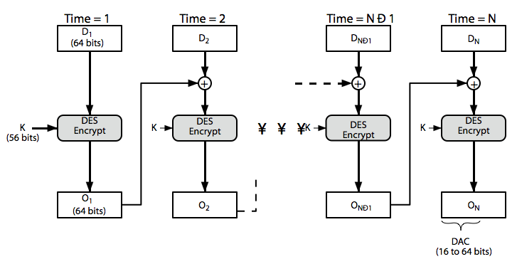
Data Authentication Algorithm
Block cipher in chaining mode (DES-CBC)
DES (Data Encryption Standard) is a block cipher
Cipher Block Chaining (CBC) is a way of chaining up block cipher as shown
D = Data
O = Output

Slide 21
Summary
MAC can provide authentication and data integrity.
MAC require a key and should be computationally diﬃcult to ﬁnd an identical MAC.
MAC function based on hash function is known as HMAC. Extra construction is added to ensure security.
MAC function could also be based on Symmetric cipher with added construction.
Notes:
Special Attention Required

